Slide 1
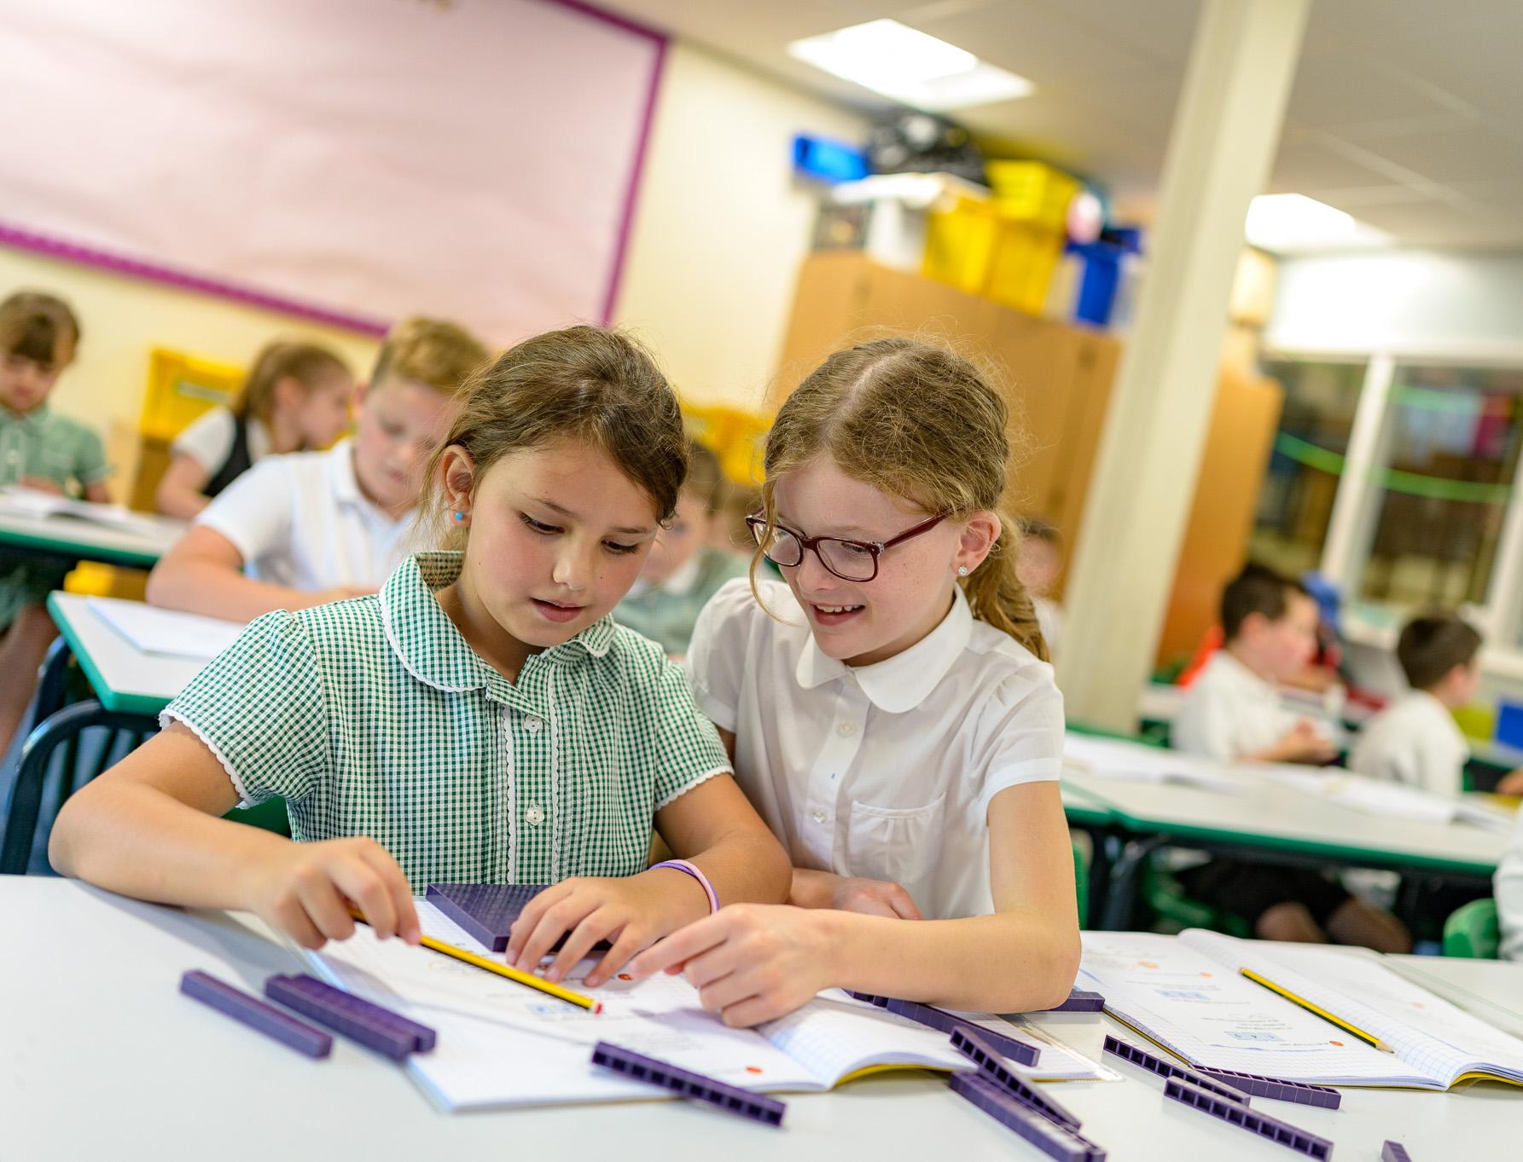
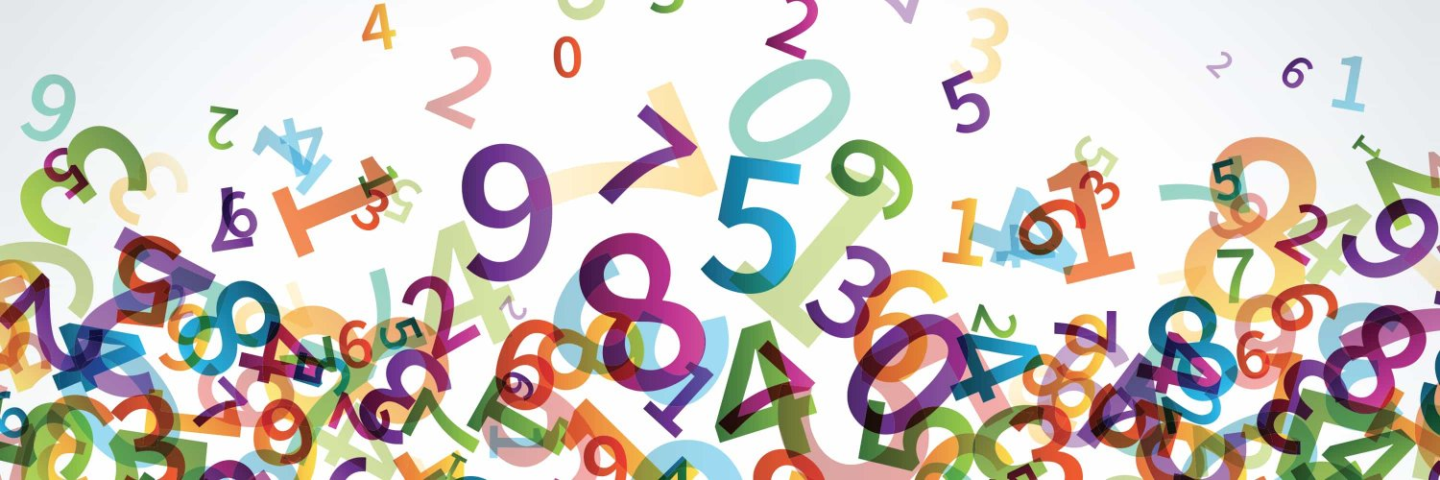

Progression in
Bar Modelling:
A Whole School Approach
Enabling children to flourish and succeed

Slide 2
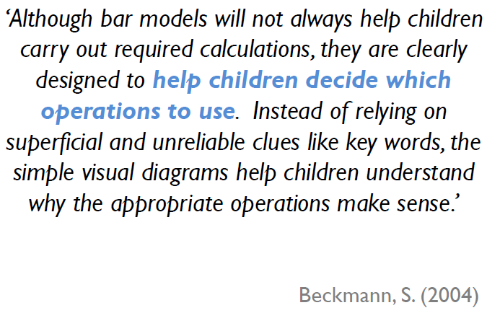
Enabling children to flourish and succeed

Slide 3
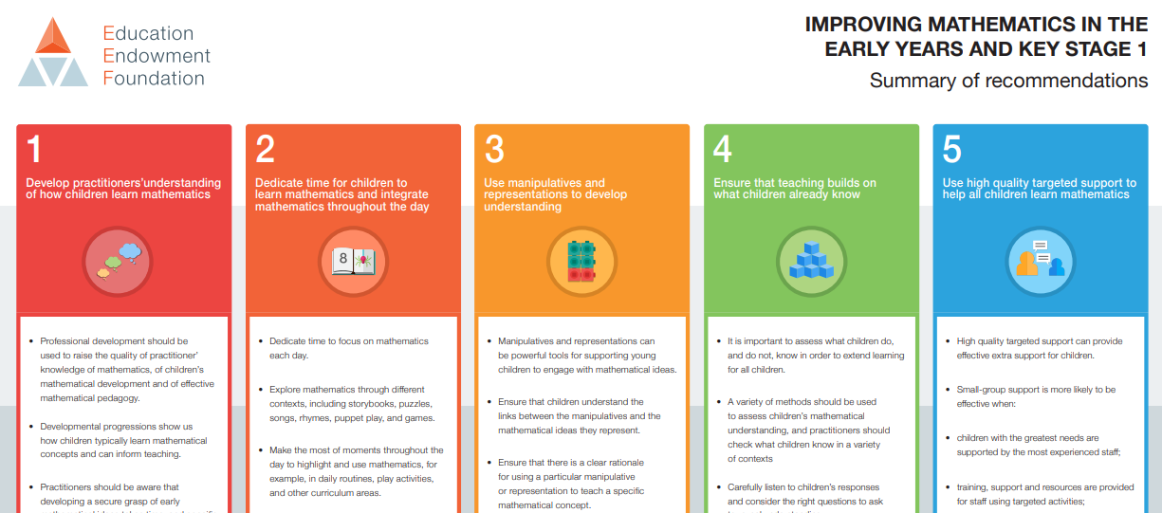
Recommendation 3:
‘Use manipulatives and representations to develop understanding’
Manipulatives and representations can be powerful tools for supporting young children to engage with mathematical ideas.
Ensure that children understand the links between manipulatives and the mathematical ideas they represent.
Ensure that there is a clear rationale for using a particular manipulative or representation to teach a specific mathematical concept.
Enabling children to flourish and succeed

Slide 4
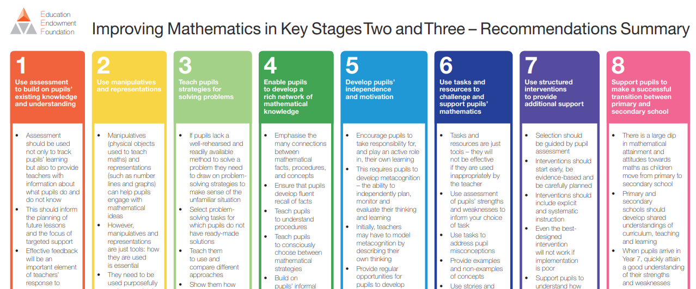
Recommendation 3:
‘Teach pupils strategies for solving problems’
If pupils lack a well-rehearsed and readily available method to solve a problem they need to draw on problem solving strategies to make sense of the unfamiliar situation.
Select problem-solving tasks which pupils do not have ready-made solutions.
Enabling children to flourish and succeed
Notes:
AD
4

Slide 5

Developing a whole school policy:
Key Principles for the Effective use of Bar Modelling
Bar Models are used to visualise a problem (not to calculate).
Embed the explicit teaching of bar modelling across all areas of maths.
Progress from interpreting bar models to encouraging children to draw their own. This can also help to differentiate support.
Progress from discrete to continuous bar models.
Enabling children to flourish and succeed
Notes:
AD
5

Slide 6
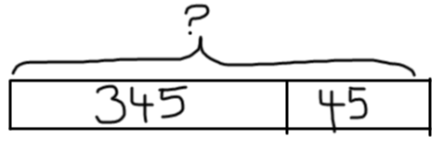
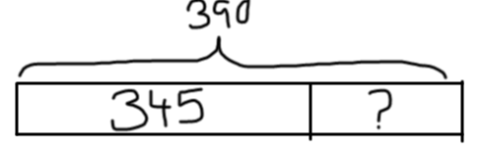
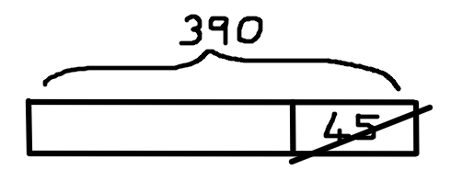

Bar models reflect the structure of a problem…
Addition
Subtraction: Partitioning
Subtraction: Reduction
Subtraction: Difference
Notes:
David has £3.45 in his piggy bank and adds 45p. (addition)
David had £3.90 and spent 45p. How much did he have left? (subtraction: reduction)
David had £3.90 and Mohammad had £3.45. How much more money did David have? (subtraction: difference)
Altogether, David and Mohammad had £3.90. If Mohammad had £3.45, how much did David have? (subtraction: partitioning)
Which bar model has two bars? Why?
6

Slide 7

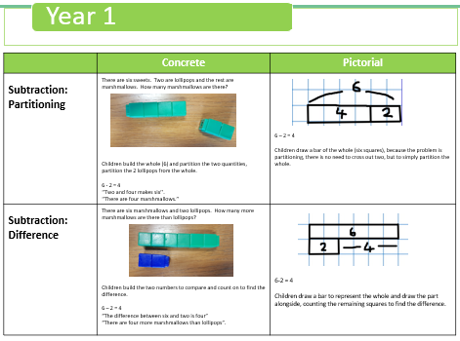
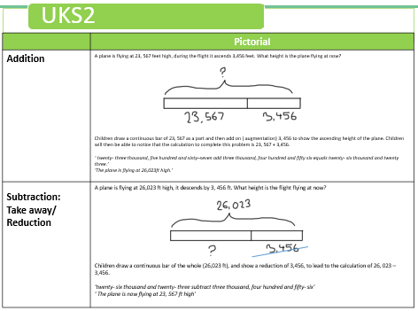
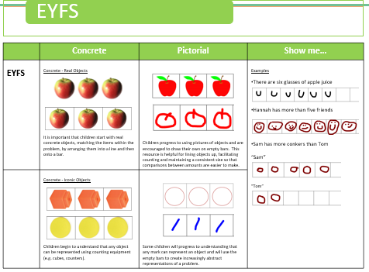
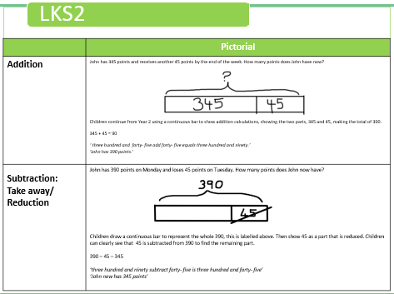
Bar Modelling Policy:
Progression from EYFS to Year 6
Notes:
AD
7

Slide 8

Bar Modelling Policy
Teaching children to visualise problems:
Progression from EYFS to Year 6
Adopted by the RISE Multi-Academy Trust family of schools.

Slide 9

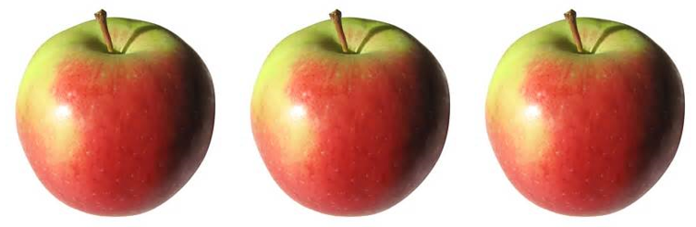


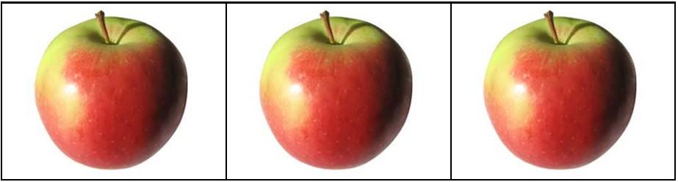


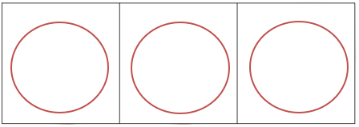
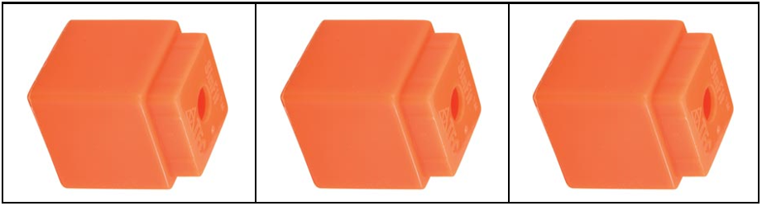


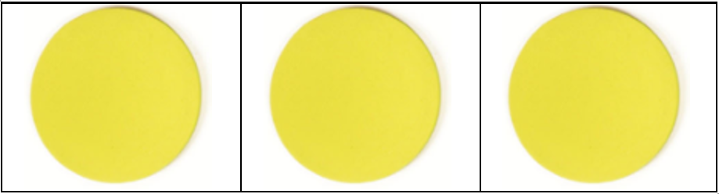
EYFS
 | Concrete | Pictorial | Show me…
EYFS | Concrete - Real Objects It is important that children start with real concrete objects, matching the items within the problem, by arranging them into a line and then onto a bar. | Children progress to using pictures of objects and are encouraged to draw their own on empty bars. This resource is helpful for lining objects up, facilitating counting and maintaining a consistent size so that comparisons between amounts are easier to make. | Examples There are six glasses of apple juice Hannah has more than five friends Sam has more conkers than Tom “Sam” “Tom”
 | Concrete - Iconic Objects Children begin to understand that any object can be represented using counting equipment (e.g. cubes, counters). | Some children will progress to understanding that any mark can represent an object and will use the empty bars to create increasingly abstract representations of a problem.

Slide 10
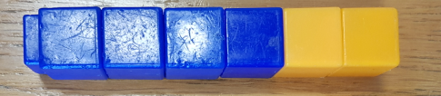
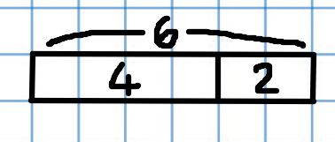
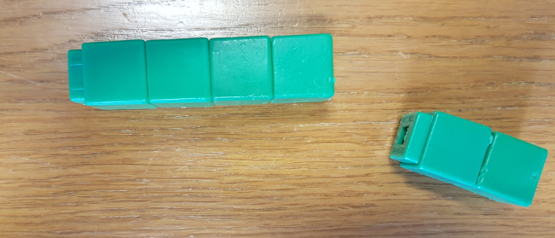
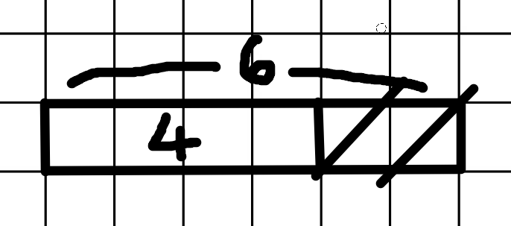
Year 1
 | Concrete | Pictorial
Addition | Peter has 4 apples. He buys 2 more apples. How many does he have altogether? Building from the iconic objects used in EYFS, cubes are used in a connected bar. One cube represents one object (discrete bar model) and each part is a different colour. 4 + 2 = 6 “Four plus two equals six” “Peter has six apples”. | 4+2 = 6 Children progress to drawing bars, using one square to represent one object (discrete bar model).
Subtraction: Take away/ Reduction | Sam had 6 sweets and ate 2 sweets. How many sweets are left? Children build the whole amount and remove two, being left with four. 6 – 2 = 4 “Six take away two equals four” ‘’Sam now has 4 apples’’. | 6-2 = 4 Children draw a bar to represent the whole and cross out to take away, labelling the whole and remaining part.

Slide 11
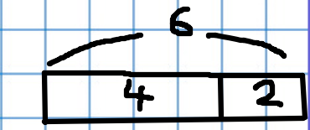
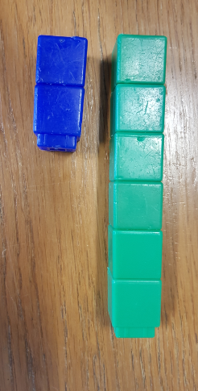
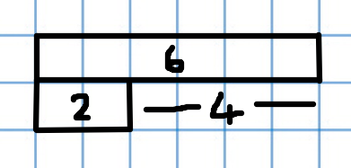
Year 1
 | Concrete | Pictorial
Subtraction: Partitioning | There are six sweets. Two are lollipops and the rest are marshmallows. How many marshmallows are there? Children build the whole (6) and partition the two quantities, partition the 2 lollipops from the whole. 6 - 2 = 4 ‘’Two and four makes six’’. ‘’There are four marshmallows.’’ | 6 – 2 = 4 Children draw a bar of the whole (six squares), because the problem is partitioning, there is no need to cross out two, but to simply partition the whole.
Subtraction: Difference | There are six marshmallows and two lollipops. How many more marshmallows are there than lollipops? Children build the two numbers to compare and count on to find the difference. 6 – 2 = 4 “The difference between six and two is four” “There are four more marshmallows than lollipops”. | 6-2 = 4 Children draw a bar to represent the whole and draw the part alongside, counting the remaining squares to find the difference.

Slide 12
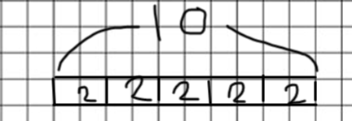
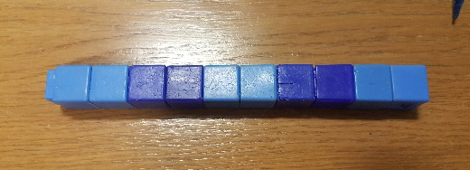
Year 1
 | Concrete | Pictorial
Multiplication | John has 5 pots, in each pot he has 2 pencils, how many pencils does he have all together? Children are taught to count in multiples of 2s, 5s, and 10s. To begin with, practice counting using concrete images. 2 + 2 + 2 + 2 + 2 = 10 ‘ two add two add two add two add two equals ten’ ‘John has 10 pencils altogether’ | Represent the concrete resources as a pictorial image. Each square has the value of one (discrete).

Slide 13
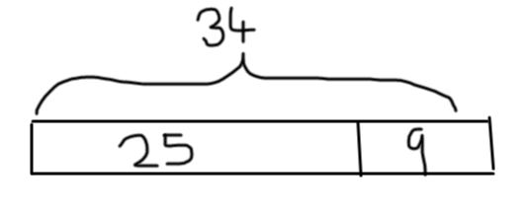
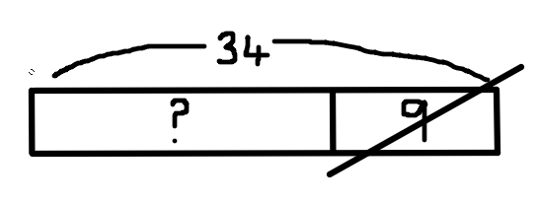
Year 2
 | Pictorial
Addition | John has 25 chocolate buttons and 9 milky way stars. How many pieces of chocolate does he have? Building on from the discrete bar model in year 1, children now start to use the continuous bar model, whereby the value of each block can represent more than the total number of squares. This can be created by drawing bars on plain paper. 25 + 9 = 34 ‘twenty- five add nine equals thirty- four’ ‘John has 34 pieces of chocolate.’ | Children move on to drawing bars on square paper, like Year 1, however the value of each bar is dependent on the representation between the values, not one square = unit of one. This is known as a ‘continuous bar model’. It’s important to move to a continuous model because it becomes inefficient to represent 25 chocolate pieces using twenty- five squares. To emphasise this change, use plain paper, so that children don’t try to count the squares. 25 + 9 = 34
Subtraction: Take away/ Reduction | John has 34 chocolate buttons, he eats 9 of them. How many chocolate buttons does he have left? Building on from Year 1, children now use pictorial bars to represent larger values without needing one cube to represent the unit of one. 34 – 9 = 25 ‘John has 16 pieces of chocolate left.’ The value that is reduced is crossed out, to show that it has been taken away from the whole (34).

Slide 14
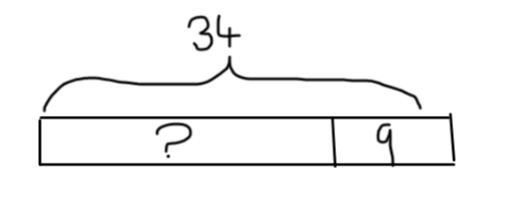
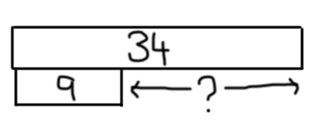
Year 2
 | Pictorial
Subtraction: Partitioning | John has 34 chocolates. 9 are chocolate stars. How many chocolate buttons does he have?
Subtraction: Difference | John has 34 chocolate buttons and 9 chocolate stars How many more chocolate buttons does John have that chocolate stars? Children represent the two amounts alongside each other to compare, using a continuous model. 34 will be a wider bar because it is more than 9. Children can then see that in order to find the difference between 34 and 9, they either need to count on from 9 or back from 34. 34- 9 = 25 ‘ the different between thirty- four and nine is twenty- five’ ‘ There are 25 more chocolate buttons than chocolate stars’
Children use pictorial bars to represent the calculation, however, instead of taking away, children partition to show two parts of the whole (34), part (9 chocolate stars) and the other part ( 25 chocolate buttons).
34 – 9 = 25
‘thirty- four subtract nine equals 25’
‘John has 25 chocolate buttons’

Slide 15
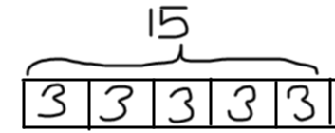
Year 2
 | Pictorial
Multiplication | There are 5 plates, with 3 cupcakes on each plate. How many cupcakes are there altogether? Children use the continuous model to represent multiplication number sentences. Adding the same amount to each part to build a bar model. 3 x 5 = 15 3 + 3 + 3 + 3 + 3 = 15 ‘ three multiplied by five equals fifteen’ ‘There are 15 cupcakes altogether’

Slide 16
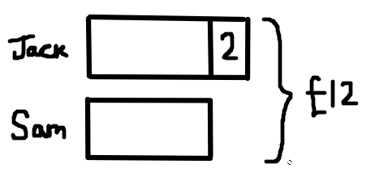
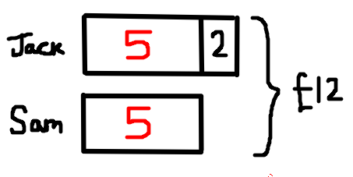
Year 2
 | Pictorial | Worked Example
Complex Problem | Together Jack and Sam have £12. Jack has £2 more than Sam. How much money does Sam have? £12 - £2 = £10 £10 ÷ 2 = £5 By drawing out a comparative bar, children can visualise that between Jack and Sam they have £12 altogether, Jack’s bar (amount) has £2 more. Modelling this example will really help children to be able to complete complex problems were children don’t know where to start or don’t know what to do with the numbers within the problem (£12 and £2). First, children subtract £2 away from £12 pounds. Then divide £10 by 2, to represent how much money Sam has, labelling each unknown amount as it is calculated. | Step 1: £ 12 - £2 = £ 10 Step 2 : £ 10 ÷ 2 = £5 Step 3: Jack: £5 = £2 = £7 Sam: £5

Slide 17
LKS2
 | Pictorial
Addition | John has 345 points and receives another 45 points by the end of the week. How many points does John have now? Children continue from Year 2 using a continuous bar to show addition calculations, showing the two parts, 345 and 45, making the total of 390. 345 + 45 = 90 ‘ three hundred and forty- five add forty- five equals three hundred and ninety.’ ‘John has 390 points.’
Subtraction: Take away/ Reduction | John has 390 points on Monday and loses 45 points on Tuesday. How many points does John now have? Children draw a continuous bar to represent the whole 390, this is labelled above. Then show 45 as a part that is reduced. Children can clearly see that 45 is subtracted from 390 to find the remaining part. 390 – 45 – 345 ‘three hundred and ninety subtract forty- five is three hundred and forty- five’ ‘John now has 345 points’

Slide 18
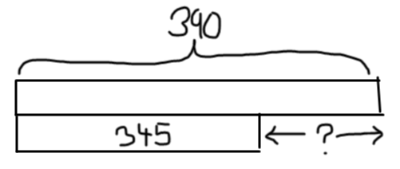
LKS2
 | Pictorial
Subtraction: Partitioning | John receives 390 points over two days, on Monday he received 345 points, how many points did he gain on Tuesday?. Children use the continuous bar to show partitioning, by representing the whole (390 points), then to show the part of 345 that John received on Monday, which leaves the other part for children to calculate. 390 - 345 = 45 ‘three hundred and ninety subtract three hundred and forty–five equals forty- five’ ‘John gained 45 points on Tuesday’
Subtraction: Difference | John has 390 points on Monday, he received 345 points on Tuesday, how many more points did he receive on Monday than Tuesday? Children use the continuous bar to show the two different amounts, one below the other. Children can then see the difference between each of the points gained on Monday and Tuesday. 390 – 345 = 45 ‘three hundred and ninety subtract three hundred and forty- five’ ‘John received 45 points more on Monday than Tuesday.

Slide 19
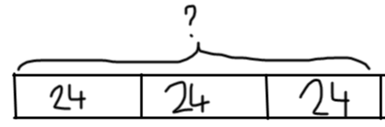
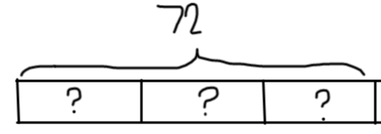
LKS2
 | Pictorial
Multiplication | There are 24 match sticks in one box, how many match sticks are in 3 boxes? It’s important for children to use the continuous bar model to show the representation of 24 x 3 (24 + 24 + 24). From using this bar model children should then be able to calculate the total. 24 x 3 = 72 ‘twenty- four multiplied by three is seventy- two’ ‘There are 72 matches altogether’
Division | 72 matches are shared equally into 3 boxes. How many matches are in each box? Here, children will draw out a continuous bar with the 72 as the whole, the bar will then need to be split in to 3 equal groups, here children can see that the calculation to solve this problem would be 72 ÷ 3. 72 ÷ 3 = 24 ‘seventy- two divided by three is twenty- four’ ‘There are 24 matches in each box’

Slide 20
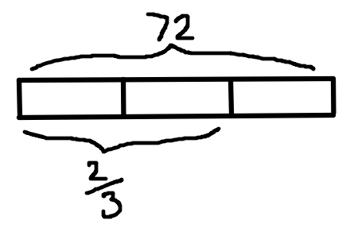
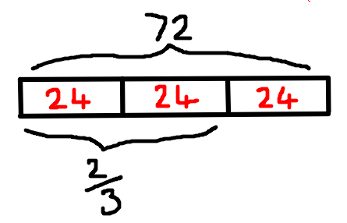
LKS2
 | Pictorial
Fractions | There are 72 matches in one box. 2/3 of the box have been used. How many matches are left? Children use the continuous bar to work out the value of ¹/₃ of the whole (72), by dividing the bar into 3 equal parts. 72 ÷ 3 = 24 ¹/₃ of 72 = 24 ‘ seventy – two divided by three makes twenty- four’ ‘ one third of seventy- two is twenty- four’ ‘ There are twenty- four matches left in the box.’

Slide 21
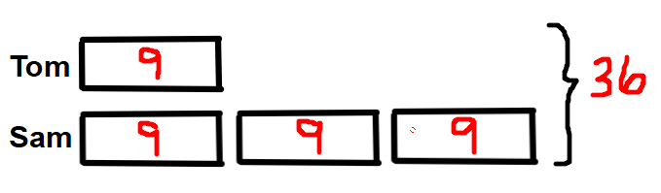
LKS2
 | Pictorial | Calculation
Complex Problem | Tom ate 9 grapes at the picnic. Sam ate 3 times as many grapes as Tom. How many grapes did they eat altogether? Drawing out a comparative bar between Tom and Sam, and labelling how many grapes Tom eats. Children then draw out 3 times as many as Tom, 9 + 9 + 9 = 27 or 9 x 3 = 27 9 + 27 = 36 Together Tom and Sam ate 36 grapes. | Step 1: 9 x 3 = 27 ( Sam has 3 times as many as Tom) Step 2: 9 + 27 = 36 (Add how many both Tom and Sam have altogether)

Slide 22
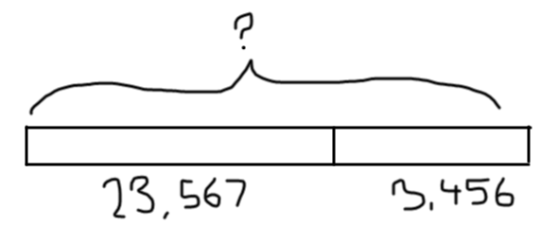
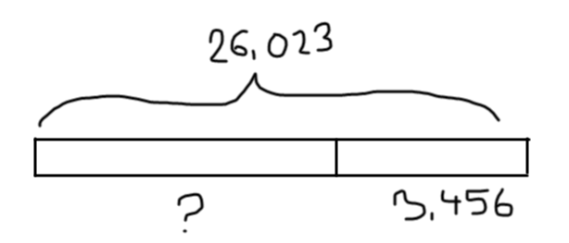
UKS2
 | Pictorial
Addition | A plane is flying at 23, 567 feet high, during the flight it ascends 3,456 feet. What height is the plane flying at now? Children draw a continuous bar of 23, 567 as a part and then add on ( augmentation) 3, 456 to show the ascending height of the plane. Children will then be able to notice that the calculation to complete this problem is 23, 567 + 3,456. ‘ twenty- three thousand, five hundred and sixty–seven add three thousand, four hundred and fifty six equals twenty- six thousand and twenty three.’ ‘The plane is flying at 26,023ft high.’
Subtraction: Take away/ Reduction | A plane is flying at 26,023 ft high, it descends by 3, 456 ft. What height is the flight flying at now? Children draw a continuous bar of the whole (26,023 ft), and show a reduction of 3,456, to lead to the calculation of 26, 023 – 3,456. ‘twenty- six thousand and twenty- three subtract three thousand, four hundred and fifty- six’ ‘ The plane is now flying at 23, 567 ft high’

Slide 23
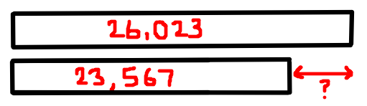
UKS2
 | Pictorial
Subtraction: Partitioning | A plane flew 26, 023 miles to Turkey via France. It travels 3,456 miles to get to France. How many miles does it travel to get to Turkey? Using the continuous bar model, children draw out the whole (26, 023) and show that part ( 3,456). Children can then subtract 3,456 from 23, 567 to find the other part. 26,023 – 3,456 = 23, 567 ‘ twenty – six thousand and twenty- three subtract three thousand, four hundred and fifty- six equals twenty- three thousand, five hundred and sixty- seven.’ ‘ The plane travelled 23, 567 miles to Turkey.’
Subtraction: Difference | A plane travels 26,023 miles to flying to France or 23, 567 miles to fly to Turkey. How many more miles does it take the plane to fly from France than to Turkey? Drawing out the continuous model of the distance to fly to France (26,023), compare it to the distance to fly to Turkey (23,567). Children can see that the remaining part is the difference between the two distances. 26,023 – 23,567 = 3,456 ‘ twenty – six thousand and twenty- three subtract three thousand, four hundred and fifty- six equals twenty- three thousand, five hundred and sixty- seven.’ ‘It took 3,456 miles more to travel to France.’

Slide 24
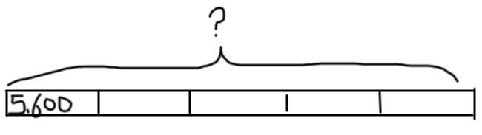
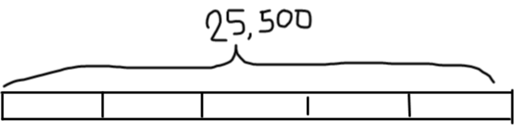
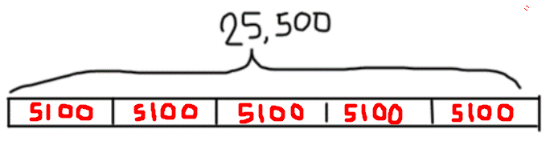
UKS2
 | Pictorial
Multiplication | In van there are 5, 600 cases of eggs. How many cases of eggs are in 5 vans? Using the bar model works well with a 4/5/ 6 digit number x by a 1 digit number, e.g. 4, 567 x 5 because this can be represented. However, a bar model shouldn’t be used for 2 digit number x 2 digit number. Here children can draw out 5 equal groups of a continuous bar of 5,600, to lead them to the calculation of 5,600 x 5. 5 , 600 x 5 = 25,500 ‘ The product of five thousand, six hundred, and five is twenty- five thousand, five hundred.’ ‘ There are 25,500 cases of eggs in 5 vans.’
Division | In 5 vans there are 25, 500 cases of eggs altogether. Each van has the same number of egg cases, how many egg cases are in two vans? Children can use the continuous bar model to show the whole of 25,500, then to divide it in to 5 equal groups to show 5 vans. Children can then lead on to the calculation of 25,500 ÷ 5 = 5100 25, 500 ÷ 5 = 5,600 ‘ twenty- five thousand, five hundred divided by five is five thousand, six hundred’ ‘ There are 5,600 cases of eggs in each van.’ 5100 x 2 = 10,200 ‘There are 10,200 cases of eggs in two vans.’

Slide 25
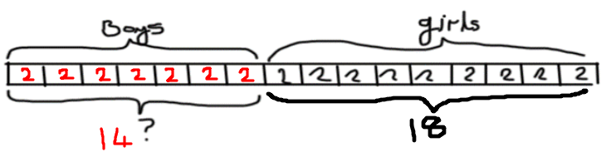
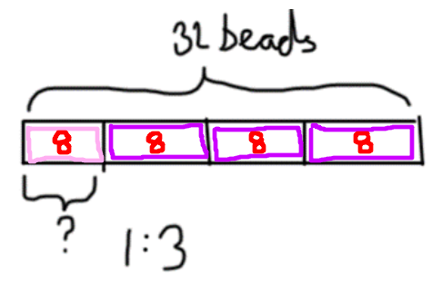
UKS2
 | Pictorial
Fractions | ⁷/₁₆ of a class are boys. There are 18 girls in the class. How many children are there altogether? Drawing out the whole with 16 parts, children can label ⁷/₁₆ as boys. Children can then visualise that ⁹/₁₆ are girls, with the label of 18. Children can then work out ¹/₁₆ is by calculating 18 ÷ 9 = 2. To work out how many children are altogether, children can work out 16 x 2 or 18 + (7 x 2). 16 x 2 =32 ‘ sixteen multiplied by two is thirty- two’ ‘ There are 32 children in the class.’
Ratio | Annie is making some necklaces to sell. For every one pink bead, she uses three purple beads. Each necklace has 32 beads in total. How many pink beads does he use to make one necklace? To represent this ratio problem, children will draw a continuous bar to represent the whole of 32 beads. They will then divide the bar in to four parts to represent the 1: 3 ratio. 32 ÷ 4 = 8 ‘thirty- two divided by four is eight’ ‘ Annie uses 8 beads to make one necklace.’

Slide 26
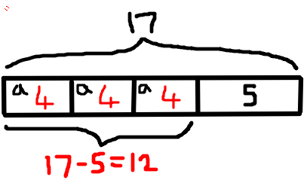
UKS2
 | Pictorial
Algebra | 3a + 5 = 17 Draw out the total of 17. Children can work backwards using the inverse operation to find the value of a, subtracting 5 from the total. Children will already know that 3a equals 3 x a, each of which has the same value. They then divide the remaining value by 3. Children work out : 17 – 5 = 12 12 ÷ 3 = 4 a= 4 ‘ a has the value of 4’

Slide 27
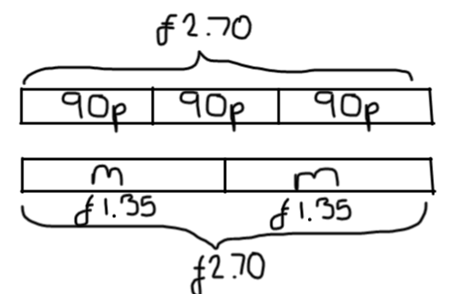
UKS2
 | Pictorial | Calculation
Complex Problems: Money Several bars should be used where several steps need to be completed | 3 pineapples cost the same as 2 mangoes. One mango costs £1.35. How much does one pineapple cost? Children should draw out two bars, one to represent pineapples and the other to represent mangoes at equal lengths to show that 3 pineapples cost the same as 2 mangoes. Step 1: Children know that 1 mango costs £1.35, the bar for mangoes should represent 2 mangoes to make the total of £2.70 . Now children know that 3 pineapples cost £2.70 Step 2: On the second bar children can now calculate how much one pineapple costs by dividing £2.70 by 3 = 90p. ‘One pineapple costs 90p’ | Step 1: £1 . 35 x 2 = £2.70 Step 2: £ 2.70 ÷ 3 = 90p

Slide 28
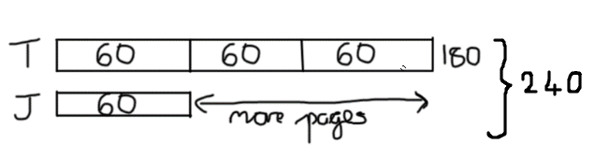
UKS2
 | Pictorial | Calculation
Complex Problems: Fractions Several bars should be used where several steps need to be completed | Tom and Jane have read pages of a book with 240 pages. Tom read ¾ of the book and Jane read ¹/₄ . How many more pages did Tom read than Jane. Firstly, children should draw a comparative bar model to represent ¾ of a book that Tom reads and ¼ of a book that Jane reads. Tom reads ¾ of this book, therefore the whole (240) should be divided by 4, which equals 60 pages. Step 1: Children can now show ¾ that Tom has read , 60 x 3 = 180 pages Step 2 Jane has only read ¼ which equals 60 pages, the difference between the two people can now be calculated. The difference is 120 pages. ‘Tom has read 120 pages more than Jane.’ | Step 1: 240 ÷ 4 = 60 Step 2: 180 – 60 = 120

Slide 29

UKS2
 | Pictorial | Calculation
Complex Problems: Compare 2 or more objects Several bars should be used where several steps need to be completed | Jessie, Lisa and David share £60 in the ratio of 1 : 2 : 3 . How much more money does David get than Jessie? When comparing values of amounts, it’s important that children draw out each bar to represent each persons amount. Between Jessie, Lisa and David, they have £60, so this is then divided between 6 ( 1: 2 : 3) = £10 per part. Labelling the amount each person has helps that children to visualise the £60 shared between the 3 people. David has £30 and Jessie has £10, so David has £20 more than Jessie. ‘David has £20 more than Jessie’ | Step 1: £60 ÷ 6 = £10 Step 2: £30 - £10 = £20

Slide 30

Consistent Representations
Consistent Picture

